Slide 1
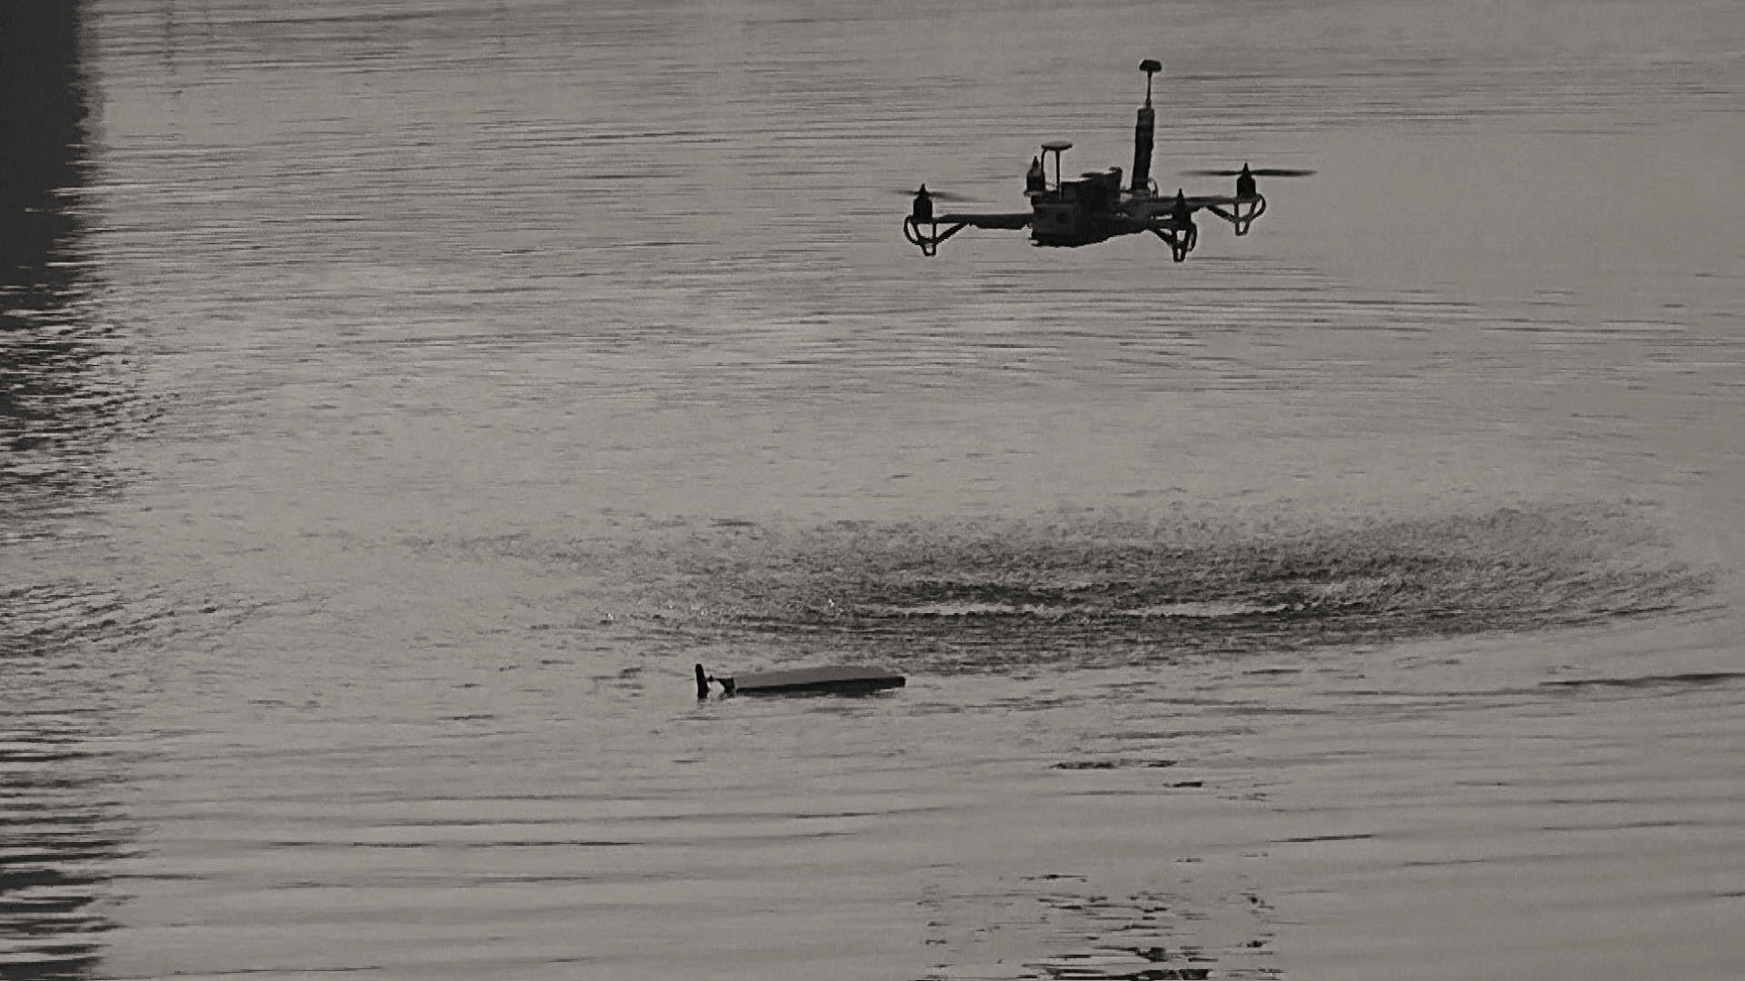
The Impact of Ground Effect on Multi-Rotor VTOL sUAS
Presented By: Gina M. Eberhart
Advisor: Dr. Jay Wilhelm
Committee Members: Dr. Sergio Ulloa, Dr. Robert Williams, Dr. Jim Zhu

Slide 2
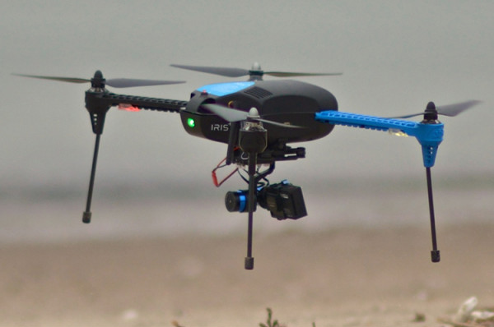
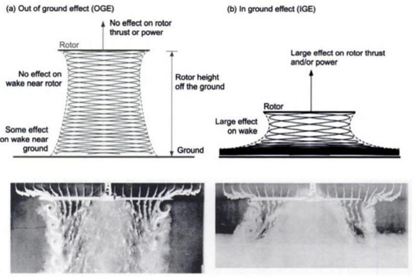
Introduction
Multi-rotor Vertical Take-Off and Landing (VTOL) Small Unmanned Aircraft Systems (sUAS)
Ground Effect
Aerodynamic perturbations close to ground
Influences both fixed-wing aircraft and rotorcraft
Multi-rotor VTOL sUAS operating Inside Ground Effect (IGE)
Flight unstable and unpredictable
Potential ancillary benefits operating IGE:
Thrust increased IGE
Required power reduced IGE
Multi-rotor sUAS hovering close to ground
Wake compression IGE vs. OGE
(Leishman 2000)

Slide 3
Problem Statement and Objectives
Problem Statement: Determine the impact of Ground Effect on flight times for multi-rotor VTOL sUAS
Objectives
Phase I
Characterize Ground Effect for sUAS class propeller
Phase II
Develop flight time prediction model for sUAS hovering IGE
Phase III
Experimentally validate flight time prediction model for sUAS hovering IGE

Slide 4
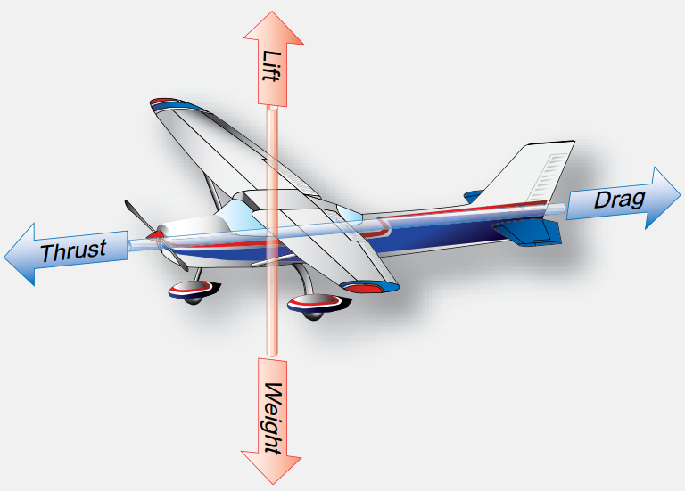
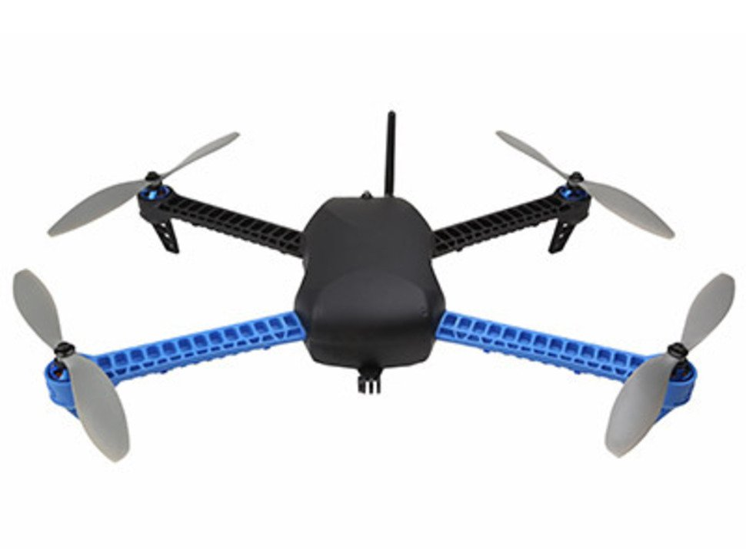
Key Findings From Literature
Unmanned Aircraft Systems
Fixed-wing
Multi-rotor
Small UAS
Rotor-Craft Aerodynamics
Momentum Theory
Blade Element Theory
Direction Control
Turbulence
Fixed-wing aircraft
Multi-rotor aircraft

Slide 5
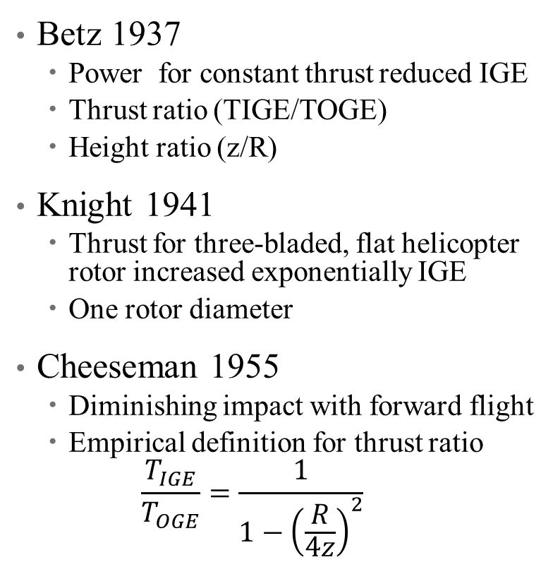
Key Findings From Literature
Betz 1937
Power for constant thrust reduced IGE
Thrust ratio (TIGE/TOGE)
Height ratio (z/R)
Knight 1941
Thrust for three-bladed, flat helicopter rotor increased exponentially IGE
One rotor diameter
Cheeseman 1955
Diminishing impact with forward flight
Empirical definition for thrust ratio
$$\frac{T_{IGE}}{T_{OGE}}=\frac{1}{1−{\left(\frac{R}{4z}\right)}^{2}}$$
Thrust Curves from Literature

Slide 6
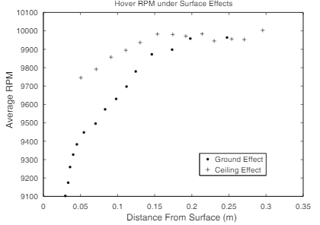
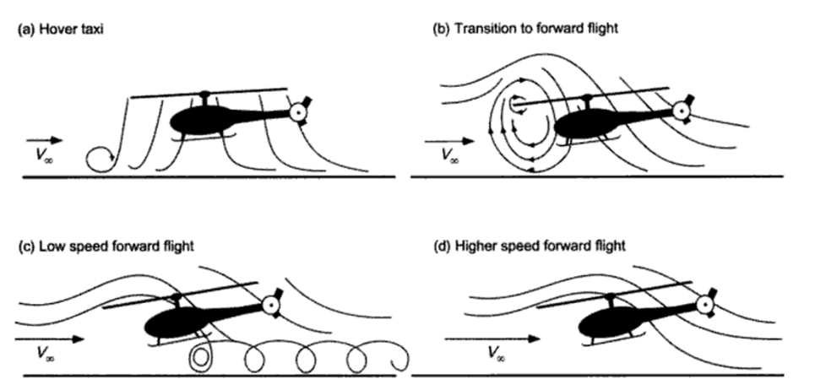
Key Findings From Literature
Curtis 1984
Diminishing impact of GE with forward flight
Light 1993
Exponential thrust curve for helicopter blade using free wake analysis method
Kushleyev 2013 and Powers 2013
Multi-rotor sUAS
RPM required to maintain hover IGE reduced
Ground and Ceiling Effect for multi-rotor sUAS
(Kushleyev 2013)
Rotor wake IGE hover, transition, forward flight
(Leishman 2000)

Slide 7

What Does GE Look Like In Flight?

Slide 8
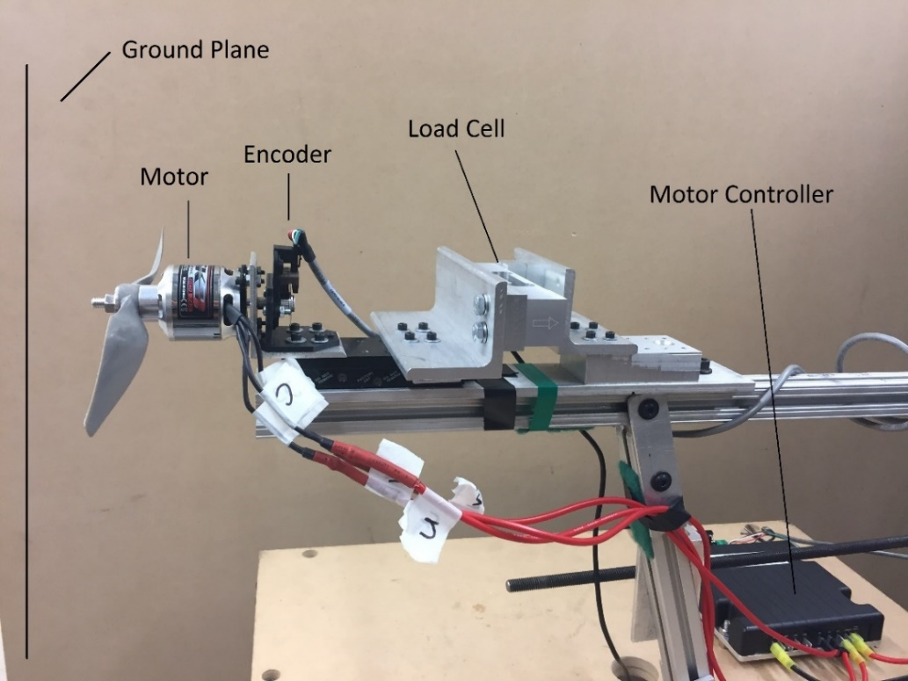
Methodology: Phase I
Objective: Characterize Ground Effect for sUAS class propeller
Hardware:
11 x 7 in sUAS propeller
Motor and Motor Controller
Optical Encoder
Load Cell and Signal Conditioner
8 Pitot Tubes and Pressure Transducers
Data Acquisition System
4 x 8 ft. Particle Board Wall
Testing Parameters:
Constant power to test stand throughout each test
Tests conducted for power settings 40-70%
Ground plane moved to each of 11 distances
Each distance sampled 3 times at random intervals
Turbulence intensity measured by pitot tubes
Thrust test rig instrumentation

Slide 9
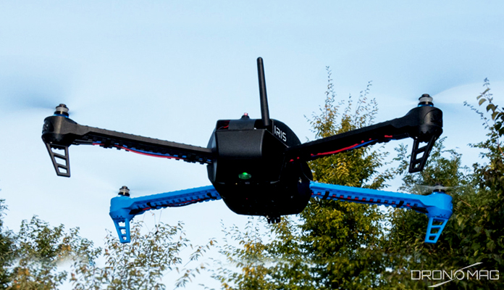
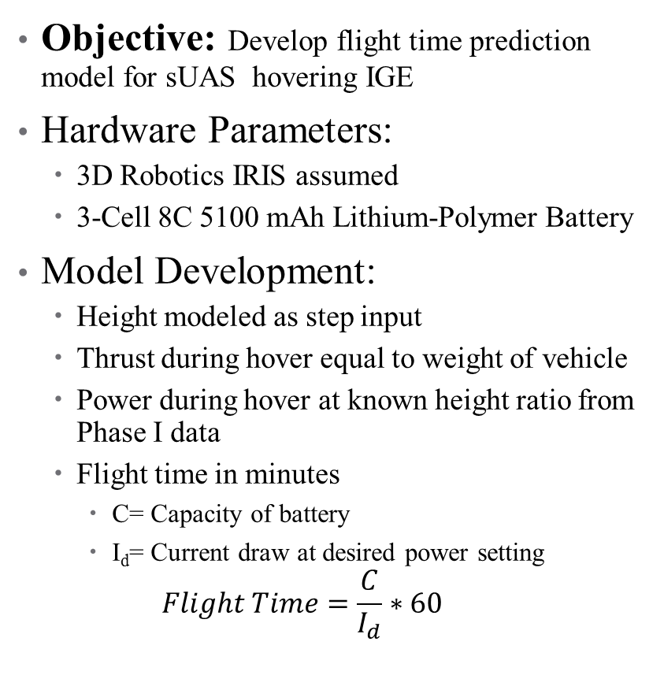
Methodology: Phase II
Objective: Develop flight time prediction model for sUAS hovering IGE
Hardware Parameters:
3D Robotics IRIS assumed
3-Cell 8C 5100 mAh Lithium-Polymer Battery
Model Development:
Height modeled as step input
Thrust during hover equal to weight of vehicle
Power during hover at known height ratio from Phase I data
Flight time in minutes
C= Capacity of battery
I_{d}= Current draw at desired power setting
$$Flight Time=\frac{C}{I_{d}}∗60$$
3D Robotics IRIS at hover
(https://www.dronomag.com/15-best-drones-for-aerial-photography-2/)

Slide 10
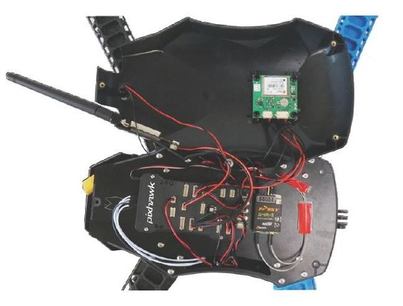
Methodology: Phase III
Objective: Experimentally validate flight time prediction model for sUAS hovering IGE
Hardware Parameters:
3D Robotics IRIS assumed for flight parameters
3-Cell 8C 5100 mAh Lithium-Polymer Battery
Vicon motion capture hardware and software
Power Sensor
Pixhawk Flight Controller
Flight Testing Parameters:
Conducted indoors
Vehicle will operate until hover can no longer be maintained
Flight time and power draw monitored
Comparison with Phase II flight time prediction model
Pixhawk flight controller on IRIS quad-copter

Slide 11
Success Criteria
Phase I
Establish relationship for thrust ratio versus height ratio for sUAS propeller at power settings from 40-70% of max power and height ratios between 0.1 and 6.5
Phase II
Flight times prediction model compares to expected flight times based on specifications of 3DR IRIS within 10% OGE and can be used to predict impact of flight close to ground
Phase III
Able to measure flight times and discern impact of flight close to ground

Slide 12
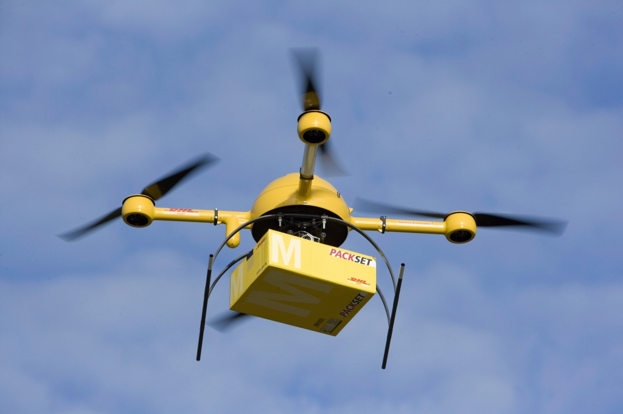
Expected Deliverables
Phase I
Conference Paper
Eberhart, G. M., & Wilhelm, J. (2017). Impact of Varied Power Setting on Thrust of Multi-Rotor VTOL sUAS in Ground Effect. In AIAA Information Systems-AIAA Infotech@ Aerospace (p. 0226).
Phase III
Final thesis document
Journal submission detailing results of Phases I-III
AIAA Journal of Guidance, Control, and Dynamics
Unmanned Systems (World Scientific)
Package Delivery by sUAS
(Ulrich Baumgarten via Getty Image)

Slide 13
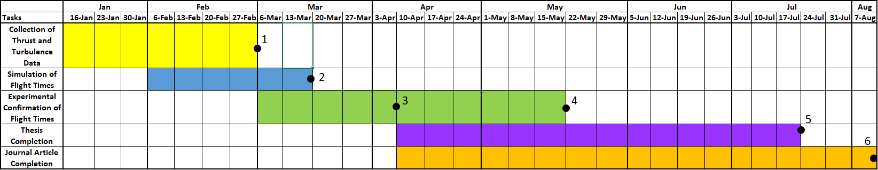
Project Timeline
Thrust and turbulence intensity data collection for select power settings and distances IGE and OGE complete
Flight time prediction algorithm for multi-rotor sUAS hovering IGE and OGE complete
Flight testing experimental setup complete
Experimental data collection for quad-rotor hovering IGE and OGE complete
Thesis document complete
Journal article complete and submitted

Slide 14
Thank You, Questions?

Slide 15
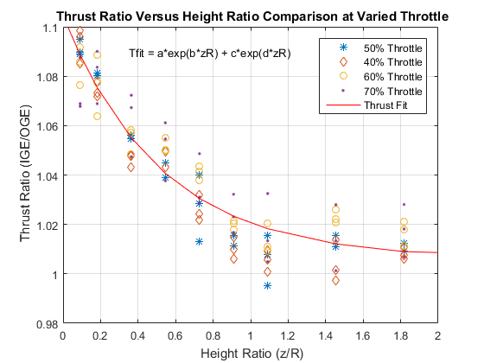
Addendum: TR vs. HR
Fit Constant | Value
a | 0.0974
b | -1.935
c | 1.007
d | -0.00049
Experimental Thrust Ratio versus Height Ratio

Slide 16
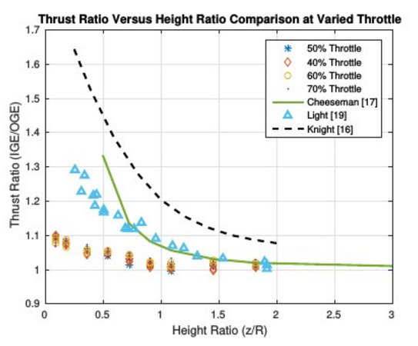
Addendum: Comparison with Literature
Thrust Ratio comparison with literature

Slide 17
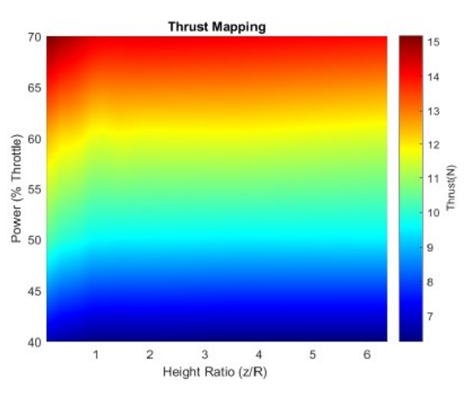
Addendum: Power, Thrust, HR Contour
Absolut thrust mapping

Slide 18
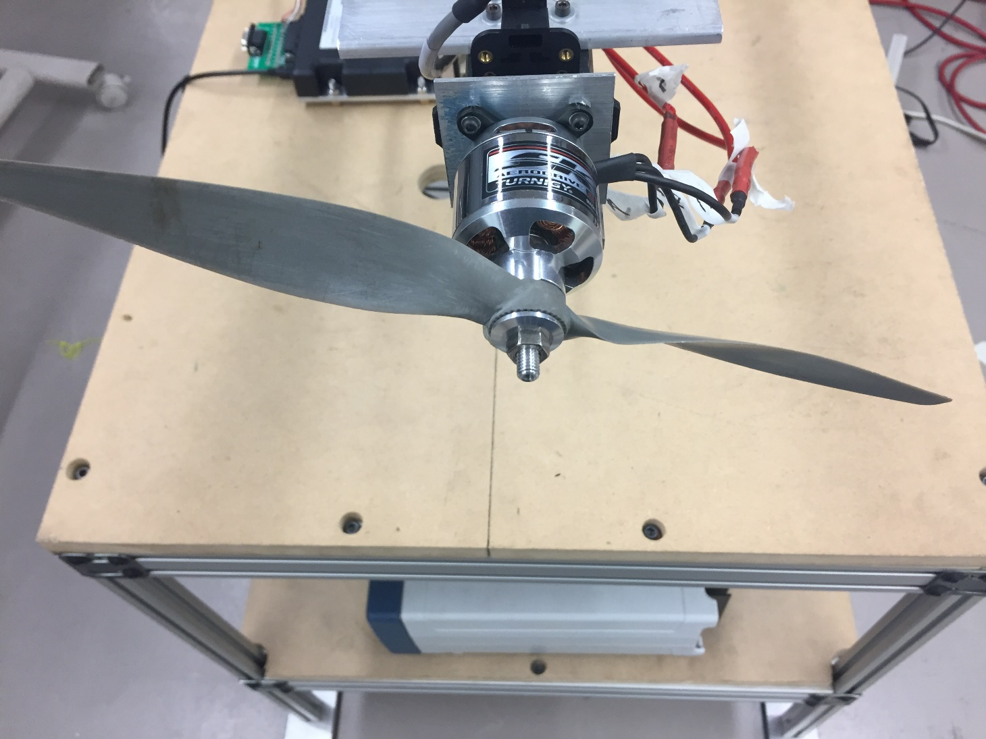
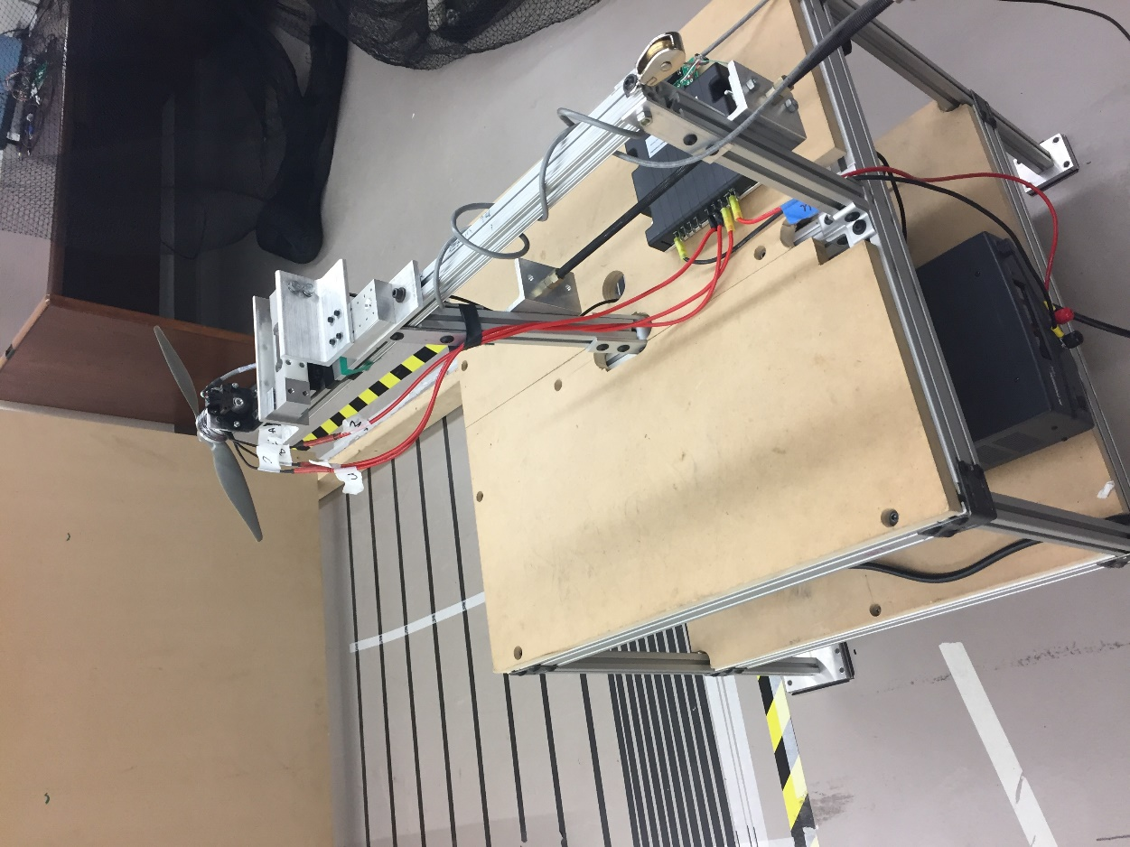
Addendum: Additional Images Thrust Rig
11 x 7 inch sUAS class propeller
Thrust test rig

Slide 19
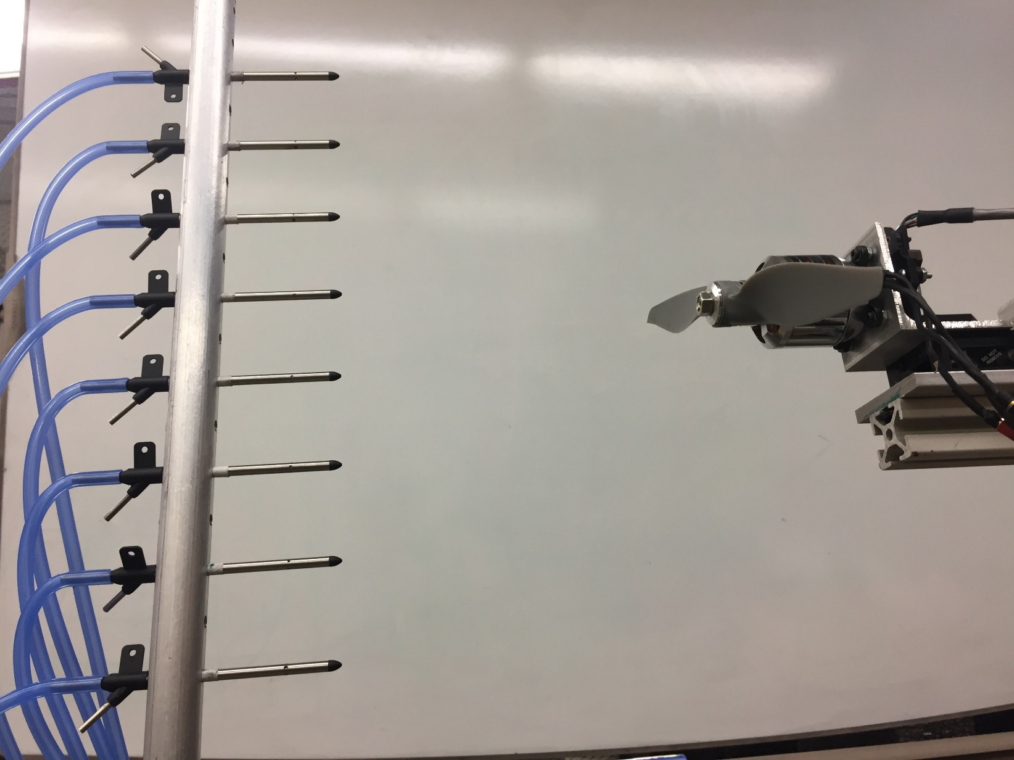
Addendum: Wake Rake
Pitot tube wake rake

